Slide 1
Let’s Practise!
15 + 3 = 26 + 1 =
20 + 6 = 31 + 3 =
42 + 3 = 56 + 5 =
Write down all the number bonds to 20 you can think of e.g. 19 + 1= 20

Slide 2
Let’s Practise!
15 + 3 = 18 26 + 1 = 27
20 + 6 = 26 31 + 3 = 34
42 + 3 = 45 56 + 5 = 61
Write down all the number bonds to 20 you can think of e.g. 19 + 1= 20
1+19 2+18 3+17 4+16 5+15 6+14 7+13 8+12 9+11
10+10 11+9 12+8 13+7 14+6 15+5 16+4 17+3 18+2 19+1

Slide 3
02.11.20 L.G. To subtract 2-digit numbers- crossing 10

Slide 4
Today we are going to learn how to subtract two-digit numbers that cross 10, using the partitioning method.
Watch the following videos:
https://www.youtube.com/watch?v=q-tF7LX7yeo
https://www.youtube.com/watch?v=WHm8KjpQr98 (from 2mins 50 secs)

Slide 6
Try these in your book:
62 – 34 = 45 – 23 =
54 – 25 = 65 – 31 =
76 – 38 = 59 – 24 =
65 – 37 = 78 – 35 =
83 – 36 = 37 – 21 =
96 – 59 = 64 – 42 =
Once you’ve completed these you can have a go at the extension problem.

Slide 7
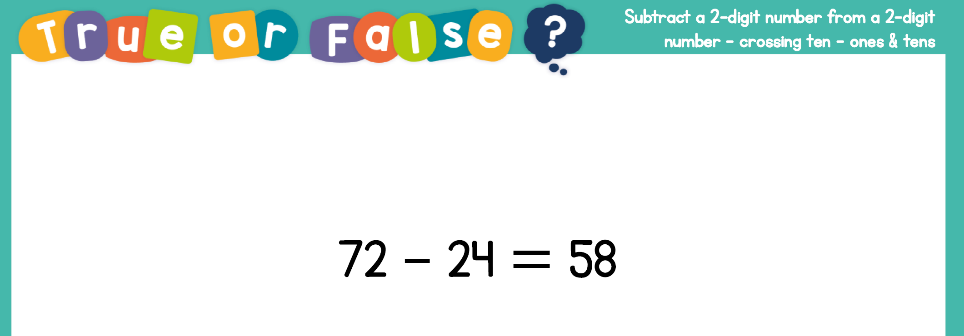
Plenary

