Slide 1
05.11.20 L.G. To subtract a 2-digit number from a 3-digit number- crossing 10 or 100.

Slide 2
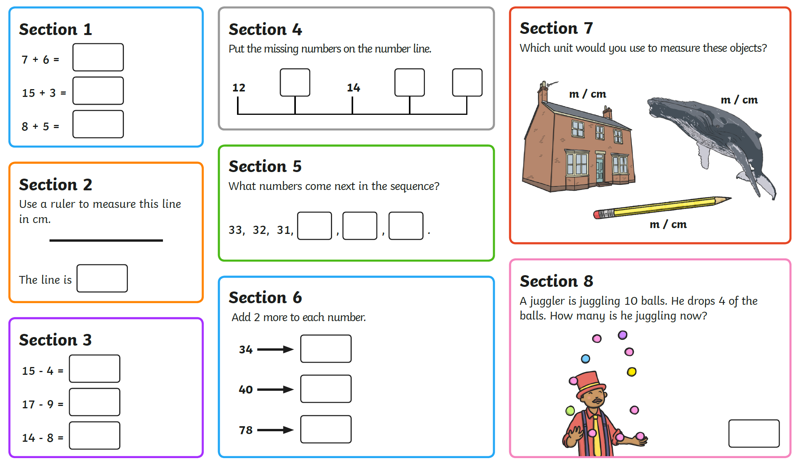

Slide 3
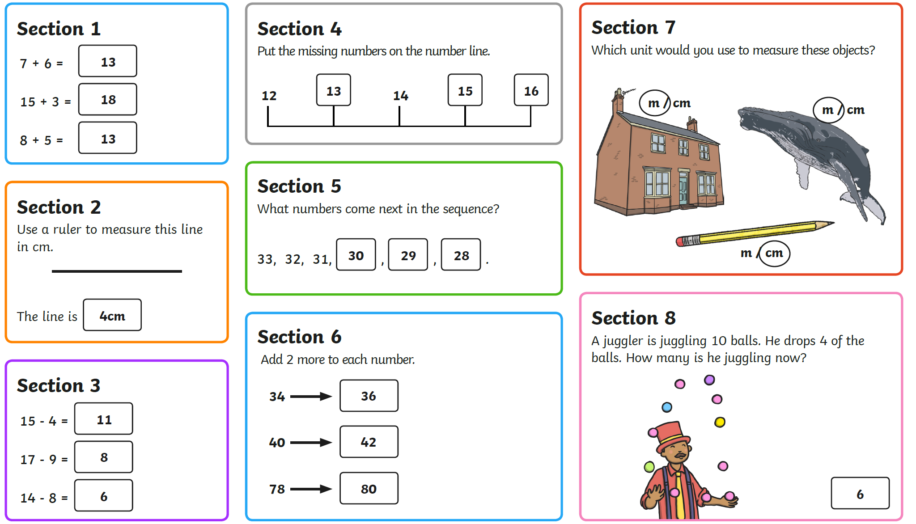

Slide 4
Can you remember how to subtract numbers using the expanded layout?
Here is an example below using 2-digit numbers:

Slide 5
How could we subtract this 2-digit number from the 3-digit number?
571 – 38=
Have a go at working out the answer on your whiteboards.
Discuss children’s workings out
Now try: 745 – 63=

Slide 6
Have a go at completing these calculations in your book:
346 – 28 = 516 – 23=
675 – 59 = 438 – 54 =
752 – 37 = 625 – 41 =
893 – 64 = 749 – 75 =
Once you’ve completed these, you can have a go at the extension problem.

Slide 7
Plenary

